Slide 1

Evaluation of Department of Energy Research and Development Activities on the Disposition of Commercial Spent Nuclear Fuel in Dual-Purpose Canisters
CSG - Midwest
Midwestern Radioactive Materials Transportation Committee
Daniel Ogg
Executive Director
U.S. Nuclear Waste Technical Review Board (NWTRB)
June 6, 2024

Slide 2


Independent Federal Agency
The U.S. Nuclear Waste Technical Review Board (Board) was established by Congress as an independent federal agency in the 1987 amendments to the Nuclear Waste Policy Act (NWPA)
NWTRB
www.nwtrb.gov

Slide 3
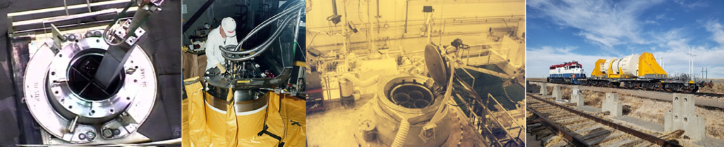
Board Mission
The Board evaluates the “technical and scientific validity” of U.S. Department of Energy (DOE) activities related to implementing the NWPA
These DOE activities include:
  Packaging of spent nuclear fuel (SNF) and high-level radioactive waste (HLW) and transportation of the wastes to a storage or disposal facility
  Site characterization, design, and development of facilities for disposing of SNF or HLW
NWTRB
www.nwtrb.gov

Slide 4
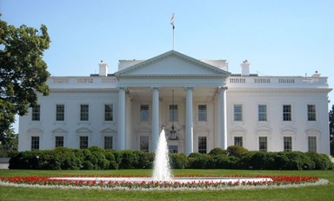

Board Members
At full strength, the Board has eleven members:
Candidates nominated by National Academy of Sciences are eminent and must have records of distinguished service
Appointed by the President
Serve part time for four-year, staggered terms
May serve until replaced
Supported by permanent, full-time staff
NWTRB
www.nwtrb.gov

Slide 5
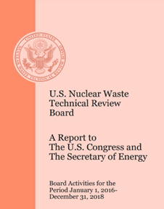

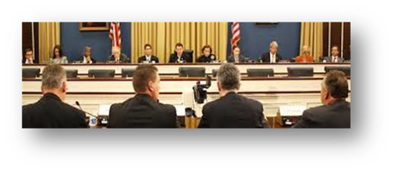
About the Board
Conducts independent and objective peer review of DOE activities
Required to report its findings, conclusions, and recommendations to the U.S. Congress and the Secretary of Energy
By law, has access to draft DOE documents – allows Board recommendations to be made during decision-making, not after the fact
Provides congressional testimony at the invitation of Congress
NWTRB
www.nwtrb.gov

Slide 6
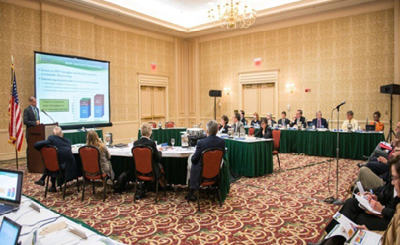
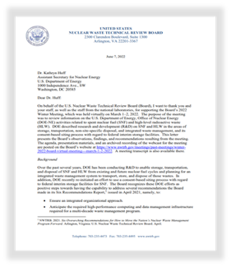
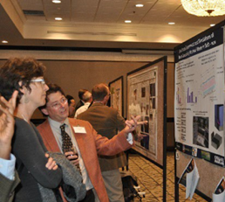
About the Board (cont.)
Holds public meetings several times per year in different geographic locations in the United States
The meetings are webcast
Provides technical and scientific comments in letters or reports to DOE following public meetings
Makes all official documents (meeting transcripts and materials, reports, correspondence, congressional testimony, etc.) available on its website: www.nwtrb.gov
NWTRB
www.nwtrb.gov

Slide 7
Current Board Members
Nathan Siu, Ph.D., Chair – Consultant, Risk Assessment
Ronald Ballinger, Sc.D. – Massachusetts Institute of Technology
Steven M. Becker, Ph.D. – Old Dominion University
Allen G. Croff, Graduate Nuc. Engr. Degree – Vanderbilt University
Tissa Illangasekare, Ph.D. – Colorado School of Mines
Kenneth Lee Peddicord, Ph.D. – Texas A&M University
Scott Tyler, Ph.D. – University of Nevada, Reno
Brian Woods, Ph.D. – Oregon State University
(Three positions vacant)
NWTRB
www.nwtrb.gov

Slide 8
Recent Board Meetings
Summer 2023 Meeting – August 29-30, 2023
  Location: Idaho Falls, Idaho
  Topic 1: International workshop on the siting of radioactive waste facilities
  Topic 2: DOE activities to develop a consent-based siting process for a federal interim storage facility; issues related to management of spent nuclear fuel
Spring 2024 Meeting – May 21-22, 2024
  Location: Knoxville, Tennessee
  Topic 1: DOE non-site specific R&D on waste disposal in crystalline rock types
  Topic 2: DOE R&D on fuel matrix corrosion after disposal
NWTRB
www.nwtrb.gov

Slide 9
Upcoming Board Meeting
Summer 2024 Meeting – August 29, 2024
  Location: Augusta, Georgia (venue TBD)
  Topic 1: DOE-EM management and plans for disposal of DOE-managed SNF
  Topic 2: DOE-NE update on overall R&D program, including developing a consent-based siting process for a federal interim storage facility
NWTRB
www.nwtrb.gov

Slide 10

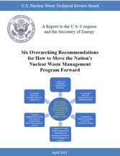
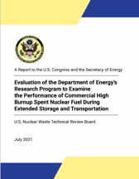
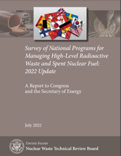
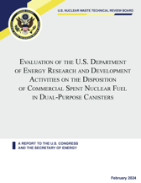
Recent Board Reports
Six Overarching Recommendations for How to Move the Nation’s Nuclear Waste Management Program Forward – April 2021
Evaluation of the Department of Energy’s Research Program to Examine the Performance of Commercial High Burnup Spent Nuclear Fuel during Extended Storage and Transportation – July 2021
Survey of National Programs for Managing High-Level Radioactive Waste and Spent Nuclear Fuel: 2022 Update – July 2022
Evaluation Of The U.S. Department Of Energy Research And Development Activities On The Disposition Of Commercial Spent Nuclear Fuel In Dual-Purpose Canisters – February 2024
NWTRB
www.nwtrb.gov

Slide 11
Report Purpose and Scope
Purpose
  Evaluate the Department of Energy (DOE) research and development (R&D) activities on disposition of commercial spent nuclear fuel (CSNF) in dual-purpose canisters (DPCs).
Scope
  Present historical context of how the nation’s CSNF came to be stored in DPCs.
  Examine three principal alternative approaches to managing CSNF:
    Indefinite dry storage of CSNF at power plant sites (for more than 80−120 years)
    Repacking CSNF into small canisters for transportation and disposal, and
    Direct disposal of SNF in large DPCs (with a focus on technical feasibility and postclosure criticality)
NWTRB
www.nwtrb.gov

Slide 12
Report Organization
Introduction
Historical Context
Alternative Approaches for the Management of CSNF
  Indefinite Dry Storage of Spent Nuclear Fuel
  Repackaging Spent Nuclear Fuel into Smaller Canisters for Transportation or Disposal
  Direct Disposal of Spent Nuclear Fuel in Dual-Purpose Canisters in a Geologic Repository
DOE Research on Direct Disposal of CSNF in DPCs
  Technical Feasibility
  Current DOE R&D on Direct Disposal
    Criticality Consequence Analysis
    Development and Testing of DPC Fillers
    Modification of DPCs to be Loaded in the Future
Board Observations, Findings, and Recommendations
NWTRB
www.nwtrb.gov

Slide 13
Observations, Findings, and Recommendations
Alternative Approaches for the Management of CSNF
Finding 1: DOE has not fully analyzed, in an integrated manner, all key aspects of the alternative approaches for managing CSNF. Particular issues to be addressed include:
The implications (time, effort, and cost) of identifying and finding a resolution for CSNF canisters that are approved by the NRC for storage, but include contents not currently approved by the NRC for transportation.
The implications on the design, construction, and operations of a geological repository of disposing large versus small SNF canisters in various rock types, with a particular focus on waste package degradation, thermal management, postclosure criticality, and the engineering aspects of waste package emplacement.
Recommendation 1: The Board recommends that DOE give higher priority to the refinement of its systems analysis tools and completion of comprehensive analyses that address issues (1) and (2) in Finding 1, as well as the other variables and complexities noted in the report. By doing so, decision-makers would be better informed of the pros and cons of the alternative approaches for implementing an integrated waste management system and better prepared to adopt one or a combination of alternative approaches that would be the most effective and efficient for the nationwide program.
NWTRB
www.nwtrb.gov

Slide 14
Observations, Findings, and Recommendations (Cont.)
Criticality Consequence Analysis
Finding 2a: The Board finds that sufficient work has been completed to define the path forward regarding analyzing postclosure criticality events. There is now sufficient information to determine going forward what simulation codes to be used in the analyses, events to be analyzed, and the parameters of interest to evaluate.
Finding 2b: The Board finds that the some of the DOE-sponsored evaluations of postclosure criticality may be based on assumptions that are not fully supportable and some of the codes used in the criticality consequence analyses may not be appropriate. (Note: see backup slides for detailed comments)
Five specific comments on modeling of steady-state criticality events
Seven specific comments on modeling of transient criticality events
Two comments apply to modeling of both steady-state and transient criticality events
Recommendation 2: The Board recommends that DOE address the points noted in Finding 2b regarding the ongoing consequence analysis of postclosure criticality.
NWTRB
www.nwtrb.gov

Slide 15
Observations, Findings, and Recommendations (Cont.)
Development and Testing of Dual-Purpose Canister Fillers
The Board observes that DPC filling experiments cannot be done on all possible canister designs and fuel loadings. The Board encourages DOE to continue with the development and validation of computational capabilities that can be used for predicting canister filling and solidification of DPC fillers for the range of canister designs and fuel loadings.
The Board observes that filler materials, especially metal/metal alloy fillers, can add significant weight to DPCs. The Board acknowledges that DOE intends to seek solutions to issues that may arise, if any, due to the added weight from DPC fillers. The Board remains interested in this topic and looks forward to reviewing DOE’s progress in the future.
The Board also observes that using fillers for DPCs and the facilities would require approval by the NRC. The Board acknowledges that DOE has taken steps to identify the regulatory considerations for the use of fillers to facilitate direct disposal of SNF in DPCs, including developing a high-level concept of operations report that could be used in future interactions with NRC.
NWTRB
www.nwtrb.gov

Slide 16
Observations, Findings, and Recommendations (Cont.)
Modification of Dual-Purpose Canisters to be Loaded in the Future
Finding 3: The Board finds that a set of criteria needs to be developed for use in assessing the various options for modifying fuel assemblies and baskets for DPCs to be loaded in the future and in prioritizing the R&D activities. The criteria could include:
  (1) how rapidly each option could be implemented in practice,
  (2) how many DPCs to be loaded in the future potentially could benefit,
  (3) the associated cost of implementation of each option per DPC, and
  (4) the criticality prevention effectiveness of each option.
Recommendation 3: The Board recommends that DOE establish a set of criteria for evaluating the various options for modifying fuel assemblies and baskets for DPCs to be loaded in the future. Using these criteria, DOE should assess the various options to determine the R&D priorities. In developing the criteria and in evaluating the various options, the Board recommends DOE consultation with fuel owners and cask vendors to gain industry insights on and acceptance of potential DPC modifications.
NWTRB
www.nwtrb.gov

Slide 17
Backup Slides
NWTRB
www.nwtrb.gov

Slide 18
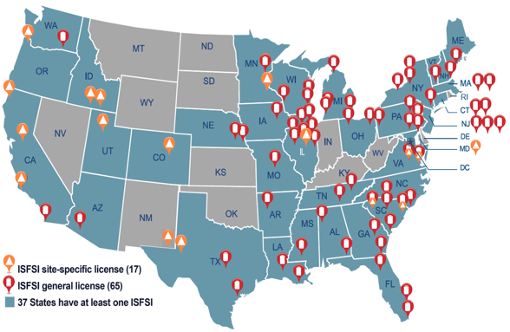
Historical Context
– U.S. Locations of Independent Spent Fuel Storage Installations
Stored at more than 70 sites, including operating and decommissioned power plants (in dry storage or in spent fuel pools)
Much of the SNF is in dry storage inside DPCs
  DPCs have been designed to serve for both storage and transportation
  DPCs are welded closed after the SNF has been loaded (versus bolted-lid casks)
Figure 1. U.S. locations of independent spent fuel storage installations (ISFSs) as of June 2023 (modified after NRC 2023)
NRC. 2023. NRC 2022–2023 Information Digest. NUREG-1350, Volume 34. Washington, D.C.: U.S. Nuclear Regulatory Commission. February
NWTRB
www.nwtrb.gov

Slide 19
Projected Inventory of U.S. Commercial SNF in Storage
Increases by over 2,200 metric tons of heavy metal per year
As of June1, 2023, almost 4,000 dry-storage casks are in-service at ISFSIs
By 2080, it is projected there will be ~136,000 MTHM of SNF in dry storage inside ~10,000 DPCs (Freeze et al. 2021)
Figure 2. Projected inventory of U.S. commercial spent nuclear fuel in storage (Freeze et al. 2021).
Freeze, G., E.J. Bonano, P. Swift, E. Kalinina, E. Hardin, L. Price, S. Durbin, and R. Rechard. 2021. Integration of the Back End of the Nuclear Fuel Cycle. SAND2021-10444. Albuquerque, New Mexico: Sandia National Laboratories. August.
NWTRB
www.nwtrb.gov

Slide 20
Finding 2b Detailed Comments
Specific comments regarding the modeling of steady-state criticality events are:
  The usage of Monte Carlo neutronic codes is appropriate.
  Down-selection to a single Monte Carlo code to complete the bulk of the analysis will produce a more consistent comparison of results and reduce the necessary verification and validation effort.
  Validation of computer modeling codes is needed, although there would be challenges in doing so given the lack of relevant data concerning time of decay and SNF canister geometry.
  Selection of a waste package thermal-hydraulic code is needed, taking into account modifications that may be needed within the code to enable modeling the waste package and whether or not the code needs to be incorporated into PFLOTRAN. This effort can build upon the work already completed utilizing STAR-CCM+ for verification. COBRA-SFS can be included in the assessment of possible codes given that it has been tailored to SNF canister applications and the applicability of its parent code, COBRA, to water-cooled reactor cores.
  The assumption of constant power over 10,000 years needs to be examined for conservatism, and if found to be overly conservative, it can be replaced with a more realistic, time-dependent power level determined by criticality that decreases over time, until negligible power is achieved.
NWTRB
www.nwtrb.gov

Slide 21
Finding 2b Detailed Comments (Cont.)
For transient criticality events, including hypothetical prompt critical events, neither the MCNP- RAZORBACK nor CASMO-SIMULATE codes appear appropriate. Both codes assume a vertical orientation of the SNF canister, which will impact hydraulic analysis relevant to certain transients. RAZORBACK employs the PKE code and a single rod thermal-hydraulic analysis, which will have limited spatial information and reactivity coefficients obtained from an MCNP analysis based upon non-transient thermal-hydraulic conditions. CASMO-SIMULATE isotopic depletion and reactor simulation capabilities are geared toward reactor core applications. Due to the lack of access to and knowledge of the source code, they are not as modifiable as needed to represent repository applications. Additional considerations for transient criticality events are:
  There is a need for a single code or package of codes (e.g., radiation code + thermal-hydraulic code) that would be applicable to all repository types and require minimum development effort. A panel of experienced reactor physics experts with knowledge of light water reactor analysis would be able to recommend such a code (or a package of codes).
  An assessment is needed to determine whether a Monte Carlo stochastic (versus deterministic) modeling approach can be employed to complete the transient simulations. A Monte Carlo modeling approach would be preferable unless it is judged to be impractical due to required computer resource and execution time.
NWTRB
www.nwtrb.gov

Slide 22
Finding 2b Detailed Comments (Cont.)
Regarding a and b above, the code that is selected would either be configurable without source code modifications to represent the systems to be simulated or have an open-access source file so modifications can be made, as needed. Compatibility of the thermal-hydraulic model with canister conditions, whether linked to an external thermal-hydraulic code or to an internal model, needs to be factored into the selection decision, recognizing that thermal-hydraulic predictions will not only be used to assess feedback effects on neutronics, but possibly also to support canister damage assessments.
If group cross-sections and spatially homogenized neutronic parameters are required, consideration needs to be given to generating these parameters utilizing a continuous energy Monte Carlo-based model of each loaded canister (i.e., with the SNF loaded in the fuel basket). If this generation approach is to be pursued, the Monte Carlo code needs to be the same as that used to complete the steady-state criticality analysis.
If a deterministic modeling approach is selected, it can be verified by comparison with Monte Carlo predictions of reactivity and power distribution at steady-state conditions for a range of thermal-hydraulic and reactivity control conditions representative transient conditions.
NWTRB
www.nwtrb.gov

Slide 23
Finding 2b Detailed Comments (Cont.)
An assessment is needed of whether fuel failure during the transient criticality event is a relevant concern. If fuel failure is relevant, modes of fuel failure other than fuel melt, which has already been identified for reactivity-induced accidents, can be examined for relevance to a repository setting.
There is a need to define the sequence of possible events leading to prompt criticality such that they are both realistic and possible to simulate.
For both steady-state and transient criticality events, the initial isotopic inventory of the canister at the start of criticality event needs to be based on UNF-ST&DARDS predictions.
There is a need to pursue uncertainty quantification to ensure that what are believed to be conservative assumptions are truly conservative when considering uncertainty.
NWTRB
www.nwtrb.gov

