Slide 1
WIPP Legacy TRU Waste Disposal Plan
National Transportation Stakeholders Forum
June 6, 2024
Michael Gerle
Environmental Regulatory Compliance Division Director
DOE Carlsbad Field Office (WIPP)

Slide 2
Legacy TRU Waste Disposal Plan
New Mexico Environment Department (NMED) issued the final Hazardous Waste Facility Permit effective on November 3, 2023.
The following Permit condition was added:
4.2.1.5 Legacy TRU Waste Disposal Plan
The Permittees shall define legacy TRU and TRU mixed waste and develop the Legacy TRU Waste Disposal Plan (Plan). The Plan will be developed in consultation with the generator/storage sites and stakeholders. Consultation with stakeholders shall begin within 90 days of the effective date of this Permit. The Plan shall be submitted to the Secretary within one year of the effective date of this Permit. The Permittees shall seek public input for 60 days following the submittal of the Plan and submit received comments to the Secretary. To the extent practicable as articulated in the final Plan, Panel 12 will be reserved for the disposal of legacy TRU mixed waste.

Slide 3
Objectives
Today: Provide background on the Legacy Waste Plan, development process, schedule, and opportunities for engagement and input
Overall:
Develop Legacy TRU Waste Disposal Plan in consultation with generator/storage sites and stakeholders.
Define legacy TRU and TRU mixed waste
Articulate how Panel 12 will be reserved for disposal of legacy TRU and TRU mixed waste to the extent practicable
Submit plan to the NMED Secretary no later than November 3, 2024 (i.e., less than one year after the effective date of the Permit)

Slide 4
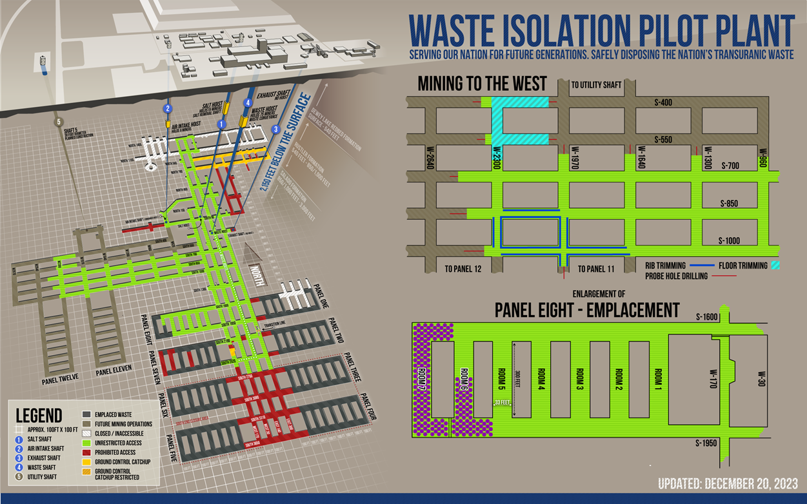
Panel 8
(current)
Panel 12
Panels 9 and 10

Slide 5
Consultation with Generator Sites
Generator site consultation and data collection
Example lines of inquiry:
How is disposition (removal) of TRU waste prioritized?
What are the engineering, risk and budget considerations?
What are the regulatory requirements and agreements driving TRU waste removal?
(How) does each site define legacy waste? Where and why is it documented?
What is the inventory of legacy waste?
What are the complexities associated with cleanup activities?
Los Alamos National Laboratory
Savannah River Site
Oak Ridge National Laboratory
Lawrence Livermore National Laboratory
Hanford Site
Argonne National Laboratory
Idaho National Laboratory

Slide 6
Consultation with Stakeholders
Other stakeholder consultation and engagement
Public meetings, direct engagement with stakeholders, members of the public, tribal nations
Dedicated web site and email address for information: https://wipp.energy.gov/Legacy-TRU-Waste-Disposal-Plan.asp and LTWDP@wipp.doe.gov
Fact sheet and soon-to-be released survey
Lines of Inquiry:
What do you consider legacy waste from your site?
(Why) Is it important to distinguish between legacy waste and other defense-related TRU waste?
What do you think would be the benefits and risks of reserving panel 12 for the disposal of legacy TRU mixed waste?
What impact could have on the missions at DOE sites?
What impact could it have on risks at/near DOE sites?
What factors should be considered in defining the phrase “to the extent practicable”?

Slide 7
Context
There is no established definition of “legacy waste.”
Panel 12 will be reserved for the disposal of legacy waste to the extent practicable.

Slide 8
QUESTIONS/ DISCUSSION
THANK YOU
https://wipp.energy.gov/Legacy-TRU-Waste-Disposal-Plan.asp LTWDP@wipp.doe.gov
Michael.gerle@cbfo.doe.gov

