Slide 1
Transportation Emergency Preparedness Program (TEPP) Update
The Council of State Governments (CSG)
Midwestern Radioactive Materials Transportation Committee (MRMTC) 2024 Meeting
Ellen Edge – DOE TEPP Program Manager
Celeste Cusack – DOE TEPP Contractor
cc@trgroupinc.com or 208-528-8895
June 6, 2024, Denver, CO

Slide 2
TEPP Update
Presentation Topics
Completed FY 2024 Training and Exercise Activities
Projected FY 2024 Training and Exercise Activities
2024 MERRTT Revision
Improvement Projects
Website Resources

Slide 3
FY ‘24 National Training Activities
Completed training sessions and headcount for YTD FY ‘24 by Regional Government Groups
Western – 26 DOE TEPP classes training 353 responders
Midwest – 3 DOE TEPP classes training 46 responders
Northeast – 22 DOE TEPP classes, 2 state-lead classes, training 304 responders
Southern – 54 DOE TEPP classes, 11 state-lead classes, training 1072 responders

Slide 4
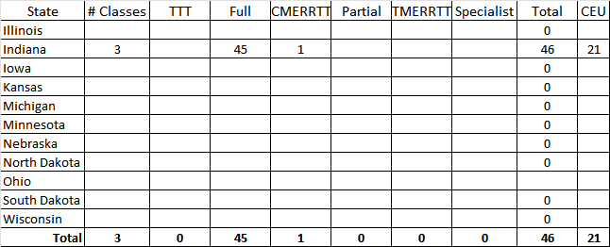
Completed FY 2024 MWCSG Training and Exercise Activities
Completed FY 2024 MWCSG Training
and Exercise Activities
Completed 3 classes that had a total of 46 responders.

Slide 5
Projected FY ‘24 MWCSG States Training and Exercise Activities
Based on available funding, TEPP plans to conducted the following training sessions for the remainder of FY 2024 across the midwestern states
~ 6 MERRTT or CMERRTT sessions

Slide 6
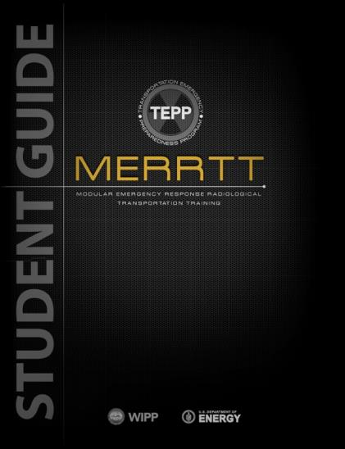
2024 MERRTT Revision Status
2024 MERRTT Revision Status
2024 MERRTT revision cycle began in early 2023
Deleted Module 15 Public Information Officer, incorporated that information into Module 9 DOE Resources and Support
Added two new incidents to Module 14 Case Histories
Updated Module 13 WIPP - numbers
Module 8 added law enforcement officer decontamination dressdown information and job aid reference
Graphic and picture updates throughout training program

Slide 7
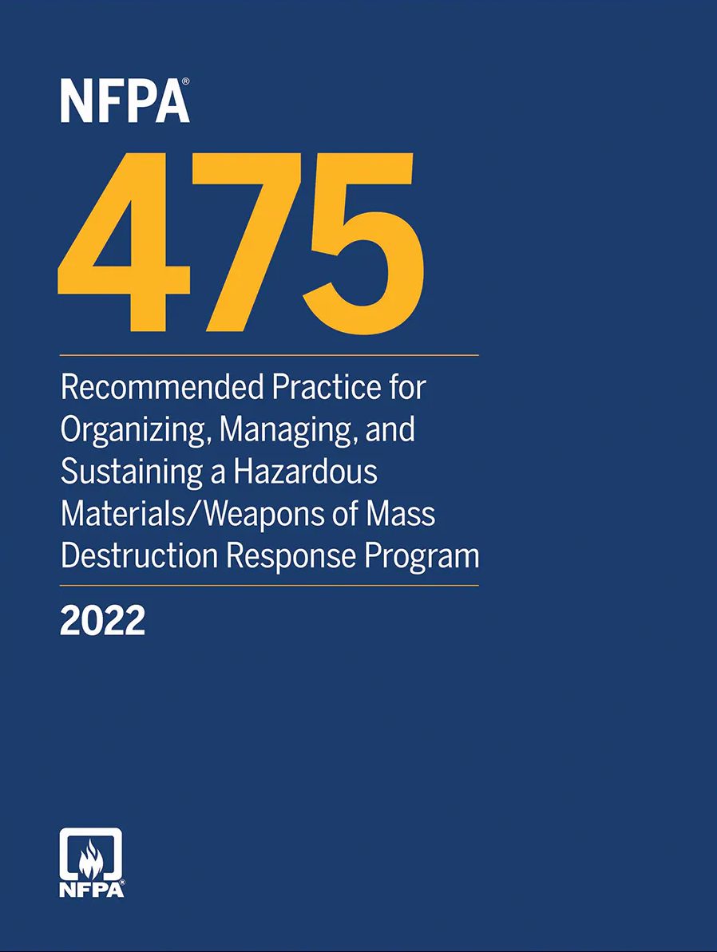
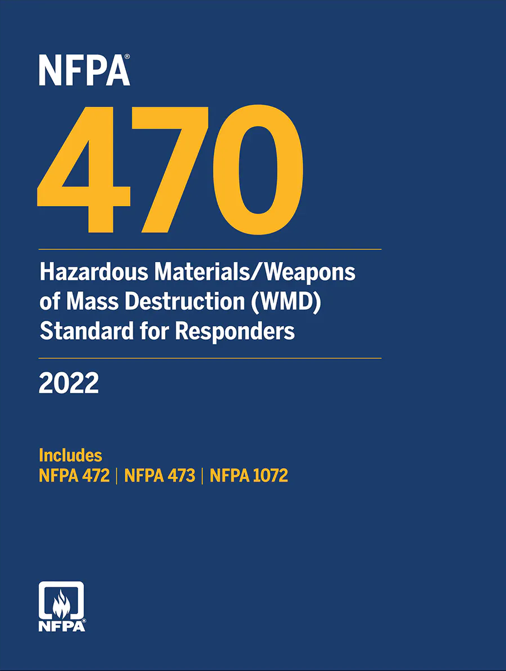
TEPP Improvement Projects
Agency Cooperation
TEPP continues to work with the National Fire Protection Association:
NFPA 470 – Hazardous Materials/Weapons of Mass Destruction (WMD) Standard for Responders
NFPA 475 – Recommended Practice for Organizing, Managing, and Sustaining a Hazardous Materials/Weapons of Mass Destruction Response Program

Slide 8
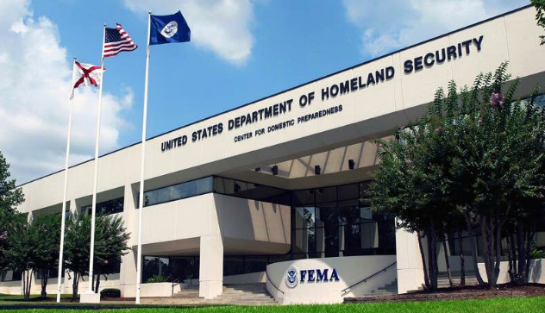
TEPP Improvement Projects
Agency Cooperation
TEPP continues to work with the Federal Emergency Management Agency Center for Domestic Preparedness (Anniston, AL)
Continue to offer MERRTT as a part of the FEMA Radiological Instructor Series
Participating in National Radiological Training Coordinating Group (NRTCG)

Slide 9
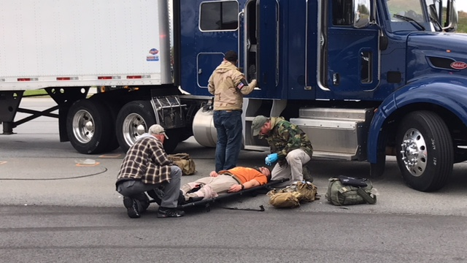
TEPP Improvement Projects
Agency Cooperation
TEPP continues to use CBRNResponder in advanced level classes
Office of Secure Transportation (OST) partnership has evolved. OST agents assist with training in select MERRTT classes.

Slide 10
Website Resources
The TEPP website provides one-stop for information
National Training and Exercise Schedule
State 24-Hour Points of Contact
Needs Assessment
Model Procedures
Exercise Planning Resources
TEPP Central Operations Contact
www.em.doe.gov/otem
www.teppinfo.com

Slide 11
Questions
?

